Slide 1
Week 09

Slide 2
Updates
Lab 07 - due Tuesday 10/26
Midterm answer key
https://github.com/pattonsgirl/Fall2021-CEG2350/blob/main/Exams/midterm-key.md
Next quiz: 10/28

Slide 3
Disks and Devices

Slide 4
Disks / Drive
The thing you are plugging in
HDD
SSD
NVME
USBs / external drives
CD, floppy disks, DVDs
We know these devices need to be communicated with. We know we have STDIN and STDOUT, and the kernel has drivers to interface with these devices. So how can they be ID’ed and worked with?

Slide 5
Devices
/dev/
Remember the first - in a permissions block
d was for directory
- meant is it some regular file
Here are more:
b = block, c = character, p = pipe, s = socket
Kernel needs drivers to utilize block and character devices
$ cat /proc/devices

Slide 6
Types of devices
Block device
Programs access data from block devices in fixed chunks
Disk devices are types of block devices
Character device
Character devices work with data streams
/dev/null, /dev/zero, /dev/random
They don’t have a size, when read or written to, kernel performs read or write on it
Printers are character devices

Slide 7
Other types of devices (fyi)
Pipe device
Named pipes are like character devices, but go to another process
Socket device
Special purpose interfaces used for inter-process communication

Slide 8
Reading /dev/
Hard disks: /dev/sd*
Virtual disks: /dev/xvd* OR /dev/vd*
Non-volatile memory devices: /dev/nvme*
Device mapper: /dev/dm-* or /dev/mapper/*
This gets into LVM, which we may not touch. We can circle back if there is interest and time in this unit or at end of course
Terminals: /dev/tty* or /dev/pts/* or /dev/tty
Terminals move characters between a process and IO device
Others: CD (sr), Serial ports (ttyS / ttyUSB), audio devices (snd / audio)

Slide 9
Disks and Filesystems

Slide 10









Schematic of a disk
Notes:
Inspiration: How Linux Works, 3rd edition

Slide 11
What a disk needs to be useful
Disk as a block device:
/dev/sda or /dev/xvda or /dev/sdh
We get a device type and an order it was discovered
Motherboards can help with ordering (which bus ids first)
Disks need:
partition table
partitions within / defined by the table
a filesystem on the partition

Slide 12
Partiton Tables
MBR and GPT are the two partition table types
MBR:
4 primary partitions, 2 TB disk size cap
Extended partition could be created to hold additional logical partitions
Think creating extended room to store the partition table
GPT:
128 partitions
each partition gets a very long globally unique identifier
Partition tables maintain where partitions on the device begin and end

Slide 13
Disk Partitioning Tools
Windows:
Disk Management
Get-Partition - Powershell
Linux:
# fdisk - Support only for MBR. Allows you to review changes and write them out
# gdisk - Support only for GPT. Allows you to review changes and write them out
# parted - supports MBR & GPT
Changes to partition table are put in place as soon as they are made
No review process!!!
Notes:
https://docs.microsoft.com/en-us/windows-server/administration/windows-commands/diskpart
https://www.redhat.com/sysadmin/partitions-parted
https://www.digitalocean.com/community/tutorials/how-to-partition-and-format-storage-devices-in-linux

Slide 14
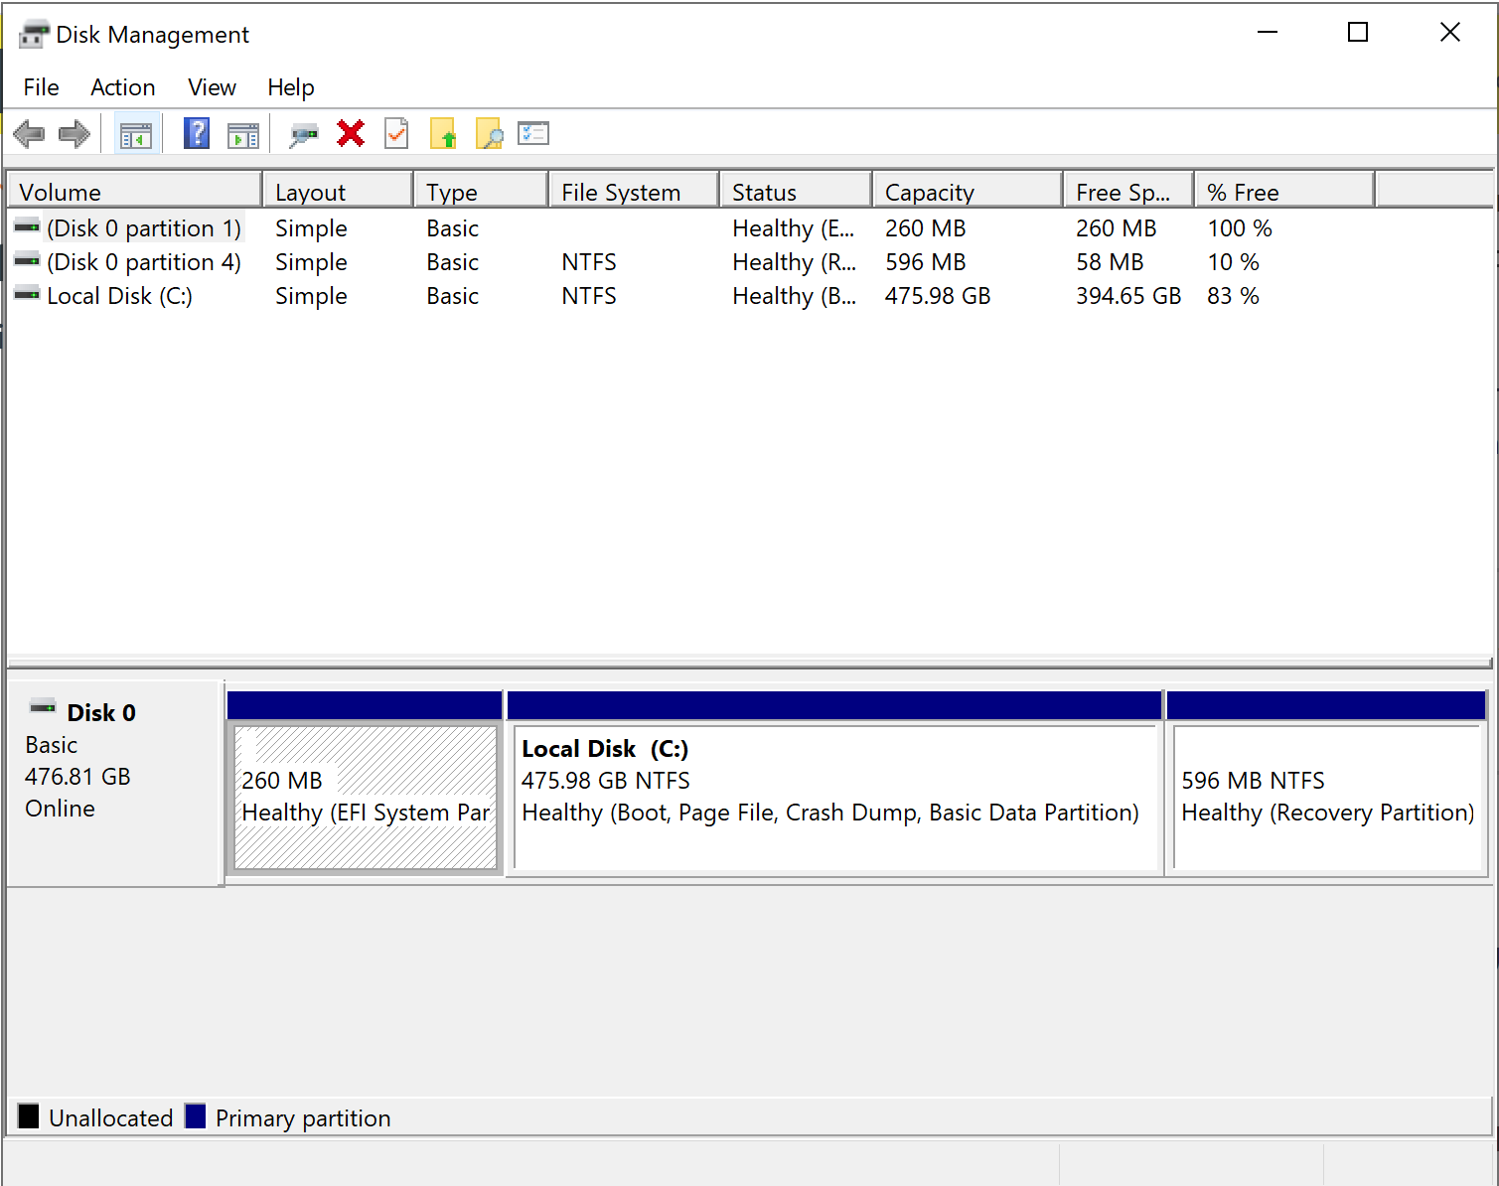

Slide 15
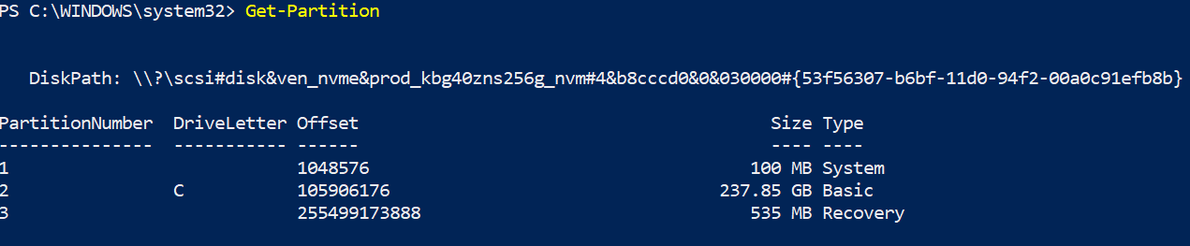

Slide 16
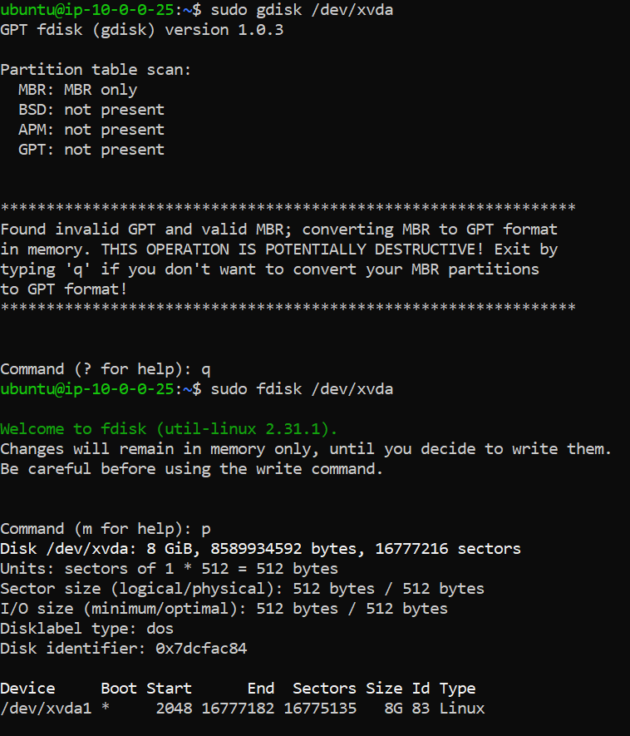

Slide 17
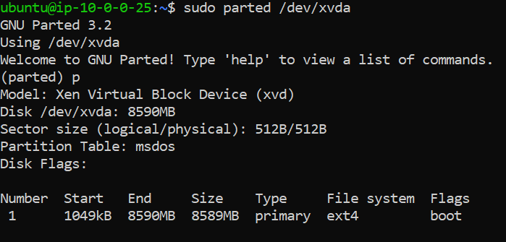

Slide 18
Why Create Partitions?
Separate data from kernel / OS
Keeps user from overloading the OS portion (always rooms for updates / core os functionalilty)
Make independent of kernel / OS
Have your data regardless of updates / version changes
Dual booting
Partition for Linux kernel / OS / user files
Partition for Windows kernel / OS / user files
Bootloader of disk would let you choose which kernel to start up

Slide 19








Slide 20













Partition
Partitions are just chunks of a block device
Still need a filesystem on a partition to make it useful
Partitions need to be mounted

Slide 21




Partition Creation Demos
Create a partition in Windows
PICK UP HERE
Create a partition on a USB drive
Create a partition on AWS
Using a volume (think adding a disk)

Slide 22






Swap space
Disk area used to store memory pages (in Linux) is called swap space
Swap can be a partition or a file
If you run out of memory, you can use the disk as an overload space
`mkswap device/file` & `swapon device /file`
How much swap?
Old rule: 2 x the amount of RAM (double the real memory)
You don’t need it - in HPCs, swap usage is bad, for example
`free`, `vmstat`
Windows: paging file (can be configured in settings)

Slide 23
Filesystems
The structure and logic rules used to manage the groups of data and their names is called a "file system.“
Without a file system, data placed in a storage medium would be one large body of data with no way to tell where one piece of data stops and the next begins
$ strings block_device

Slide 24
Filesystem types
Fourth extended filesystem (ext4)
Unix FS + Fast FS = ext2
ext3 added journaling (data integrity + faster booting)
ext4 supported larger files and more subdirectories
B-tree filesystem (Btrfs)
Newest, on track to replace ext4
FAT filesystems by Windows - vfat (up to 4GB), exfat (> 4GB)
NTFS - modern Windows default FS
XFS - high performance file system (RedHat / enterprise)
HFS+ - Apple standard
ISO 9660 - CD-ROM standard
Notes:
https://www.howtogeek.com/443342/how-to-use-the-mkfs-command-on-linux/

Slide 25
Journaling Filesystems
Journaling is an important concept in file systems.
The file systems records the pending file writes to a journal.
As each file is written to, the journal is updated, and the pending write records are updated.
This allows the file system to repair broken, partially written files that have occurred due to a catastrophic event such as a power cut.
Some of the older file systems do not support journaling.
Those that don’t, write to the disk less frequently because they don’t need to update the journal.
They may perform faster, but they are more prone to damage due to interrupted file writes.
Notes:
https://www.howtogeek.com/443342/how-to-use-the-mkfs-command-on-linux/

Slide 26





Make a filesystem
# mkfs -t fs_type blockdevice_or_file
`mkfs` determines blocks in device and sets defaults
On success, mkfs prints output that includes details about the superblock
Notes:
https://www.howtogeek.com/443342/how-to-use-the-mkfs-command-on-linux/

Slide 27
Mounting a filesystem
Need to know:
Filesystem’s device / location
Filesystem type
Mount point - place in system directory structure where filesystem will be attached
/mnt/ is a common “playground” for mounting filesystems…
# mount -t type device mountpoint
# mount -a
Useful is editing /etc/fstab, where long term “please mount” details are listed

Slide 28
Unmounting a filesystem
Kernel doesn’t immediately write out changes to a disk - changes are stored in RAM until there is a “good time” (or you hit save)
The sync command will also synchronize with the disk
Kernel may also cache a file to RAM so it doesn’t have to go back to disk
On `umount` = unmount, kernel synchronizes with disk
This is also why hitting “eject” is important and waiting for the system to indicate it is finished is a big deal

Slide 29
Lecture stopped here for week 09
Leaving following slides for assistance with Lab 07

Slide 30
Terminology of a filesystem
Superblock: file system metadata and defines the file system type, size, status, and information about other metadata structures (metadata of metadata).
dentry is the glue that holds inodes and files together by relating inode numbers to file names. Also maintains a relationship between directories and their files
inode exists in, or on, a file system and represents metadata about a file
information about ownership (user, group), access mode (read, write, execute permissions), file type, and the data blocks with the file's content
file is a block of logically related arbitrary data
Notes:
https://unix.stackexchange.com/questions/4402/what-is-a-superblock-inode-dentry-and-a-file

Slide 31


What we see
`ls`, `tree`, `cd`

Slide 32
What it really is
Pool of data blocks where you can store data
Database system that manages the data pool using the inode data structure

Slide 33
Filesystem UUID
Device names can change
Use instead their universerally unique identifier (UUID)
# blkid
List of devices and corresponding filesystems and UUIDs

Slide 34
Filesystem mount options
-r : mount filesystem in read only mode
-t : filesystem type
exec / noexec - enables or disables execution of programs on the filesystem
suid / nosuid - enables or disables setuid programs
uid - treat files as though given uid is owner
ro - mount filesystem in read only mode (long form)
rw - mount filesystem in read-write mode

Slide 35
/etc/fstab (filesystem table)
Entries contain mounting information
UUID or device
Mount point
Filesystem type
Options (long options, comma separated)
Backup info for dump command (archived, set to 0)
Filesystem integrity test order
1 for root filesystem
2 for all others
0 to disable bootup check (this is the usual)

Slide 36
Sizing up
$ df
Filesystem disk space usage
Filesystem device, 1K-blocks (capacity in blocks of 1024 bytes), used, available, used percentage, mounted on (the mount point)
$ du
File space usage. Find out what is hogging disk space

Slide 37
Repairing a filesystem
(or at least trying)
# fsck device
Filesystem must be unmounted otherwise you can cause the conflict you are trying to fix!

Slide 38
Filesystem Demos
Create a filesystem on a partition in Windows
Create a filesystem on a partition on a USB drive
Create a filesystem on a partition in AWS
Create a filesystem using a file
Introduce dd

Slide 39
dd
$ dd if=/dev/zero of=new_file bs=1024 count=1
If = input file (default is STDIN)
Of = output file (default is STDOUT)
Bs = block size - read and write x bytes of data at a time
Count = number of blocks to copy
Don’t copy “all” of /dev/zero - copy a block of it

Slide 40
Special purpose Filesystems
/proc/
Process. Each numbered directory = a process. Files inside represent aspects of the process. Contains other kernel / hardware info in files
/tmpfs/
Use RAM and swap as temporary storage. Could cause interesting snags
Squashfs
Read only filesystem where content is stored in compressed format and extracted on demand
Overlay
Merges directories into composite. Containers use these ☺

Slide 41
inodes
Internally, your OS doesn't care about your file names
Linux uses inodes
Windows uses file-IDs
Number of inodes != disk size
How many i-nodes are taken:
$ df –ih /
Disk size (blocks taken)
$ df -h /

Slide 42
inodes
I-nodes capture metadata about the file
Size
Permissions
Date modified
Where it resides on drive (which blocks)
Every file references an inode and vice-versa
$ ls -li
First column is the inode
$ stat filename

Slide 43
inodes vs blocks
There are two resources that a file system provides to the user: blocks (for data) and inodes (for file metadata).
Each file consumes one inode
File data is stored in data blocks on the disk
Assuming there are no directories, it is possible for a user to exceed his or her inode quota without using any blocks by creating all empty files.
Infinite use of `touch` command
It is also possible for a user to use only one inode yet exceed his or her block quota by simply creating one file large enough to consume all the data blocks in the user's quota.
Notes:
https://docs.oracle.com/cd/E19455-01/805-7229/sysresquotas-3/index.html

Slide 44
Available blocks
How does filesystem know which blocks are open for data storage?
Block allocation map / block bitmap
0 and 1 of free or open for each block

Slide 45
Linking
Hard link
Inode is associated with multiple file names
All files hardlinked point to the same inode & the same blocks on the disk
A change to a file changes the blocks
Soft link
A file has a inode, but it points to the inode of another file (not to blocks on a disk)
Removing the symbolic link has no effect on the real files existence
Copy
Files exist with unique inodes written to unique blocks
Move
New file name associated with inode

Slide 46
Linux - creating links
Create a file
$ ln target link_name
Check stat
$ ls --symbolic target link_name
Check stat
What type of path?
Check out --relative
What’s the problem?
Notes:
https://coffeewithbytes.com/blog/hardlink_softlink/

Slide 47
Windows – Shortcuts & Links
Symbolic links in Windows are "shortcuts"
Right click on a file to create Shortcut
Powershell:
Symbolic link
New-Item -ItemType SymbolicLink -Path "Link" -Target "Target“
Hard link
New-Item -ItemType HardLink -Path "Link" -Target "Target"
Notes:
https://winaero.com/create-symbolic-link-windows-10-powershell/

